Slide 1
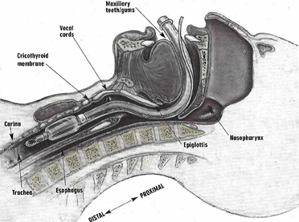
Intubation
Clerk Teaching & Assessment Template

Slide 2
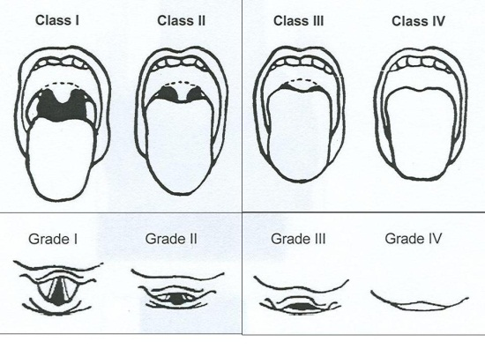
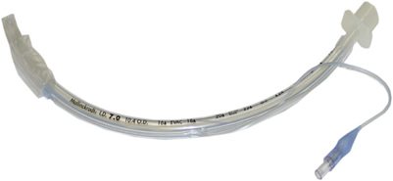
INTUBATION:
Correctly assesses airway anatomy for ease of intubation
Mouth opening
Dentition
C-Spine ROM
Mallampati score
Thyromental distance
Correctly chooses and checks equipment
Mask
Oral airway
Rescue LMA
ETT
Laryngoscope – direct, video

Slide 3
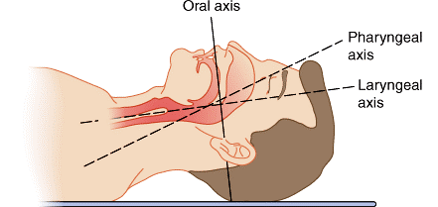
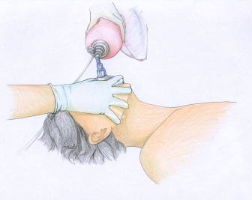
3. Correctly positions patient
Tragus in line with sternal angle
Neck flexion
Atlanto-axial extension
Ramping, shoulder roll, doughnut as appropriate
Ergonomically positioned for laryngoscopist
4. Correctly performs laryngoscopy
Checks efficacy of bag mask ventilation
Achieve “sniffing” position
Correctly inserts laryngoscope, engaging thyroepiglottic ligament
Compresses sublingual tissues, avoiding levering action
Recognizes view of larynx

Slide 4
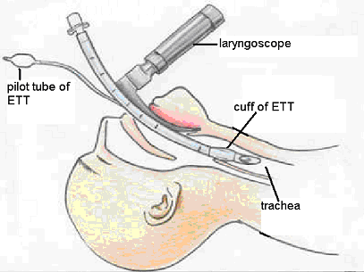
5. Correctly intubates
Identifies glottic inlet, vocal cords
Successfully passes endotracheal tube through vocal cords
Stops in the trachea, cuff inflated
Assesses placement – CO₂, chest rise, misting, auscultation
Keeps work area clean (clean & dirty areas)

